Slide 1
Improving patient experience using AI
Student Number: 100611584
Module: Data Mining and Foundations of AI

Slide 2
Problem Analysis
Problem Statement
The project is to develop an AI driven solution that predicts patients at risk of clinical deterioration based on healthcare data

Slide 3
Dataset
The dataset used for this project was sourced from Kaggle Here.
PURPOSE
simulate real-world healthcare data for training an evaluating AI models
useful in the healthcare context given it allows for testing ML algorithms without using sensitive patient data.
FEATURES
Demographic data – age, gender …
Health metrics – blood pressure, cholesterol levels, BMI …
Medical history – past diseases, medication, healthcare visits
Lifestyle data – physical activity, smoking, alcohol consumption
STRENGTHS
clean and well structured (to implement in AI based projects)
Helpful for various scenarios (can have different target variables)
LIMITATIONS
Might not fully represent complexity and noise of real-world data

Slide 4
Ai model selection
When choosing models for an AI solution predicting patients at risk of clinical deterioration based on healthcare data, there are several factors to consider:
Problem type: the task is to classify patients based on the target variable; therefore, we’re working with classification models to categorise them into different risk groups
Feature types: since the dataset contains both categorical and continuous features, the model should be able to process both types of data effectively
Interpretability: while not used in this project, in general with the integration of AI into healthcare, a level of trust is needed from professionals. Having models that work well with explainability will ensure this trust and transparency, enabling a better understanding of the rationale behind predictions.
The Chosen Models: Random Forest and Logistic Regression were chosen for their complementary strengths. RF handles complex, mixed-type data well and captures the non-linear relationships however it can lack interpretability (which isn’t so much an issue in this project.) LR is simple, interpretable and ideal for clear clinical insights. However, it assumes linear relationships and may miss complex patterns.
The combination balances predictive power with transparency, fitting the needs of a healthcare setting such as this.

Slide 5
Development process
The problem of late deterioration detection was tackled by creating a binary target based on recovery time (> 5 days = at risk). Preprocessing steps like dropping irrelevant features, encoding categoricals, handling missing values, and scaling numericals ensured clean, usable data.
An 80/20 split balanced training and evaluation. Random Forest was chosen to handle complex data patterns, while Logistic Regression provided a simple interpretable baseline.
Models were evaluated using accuracy using ROC-AUC, confusion matrix, and classification report to critically assess predictive performance in a clinical context.
Defining the problem
Creating the target variable
Data preprocessing
Train/test split
Model training
Random forest
Logistic regression
Model evaluation

Slide 6
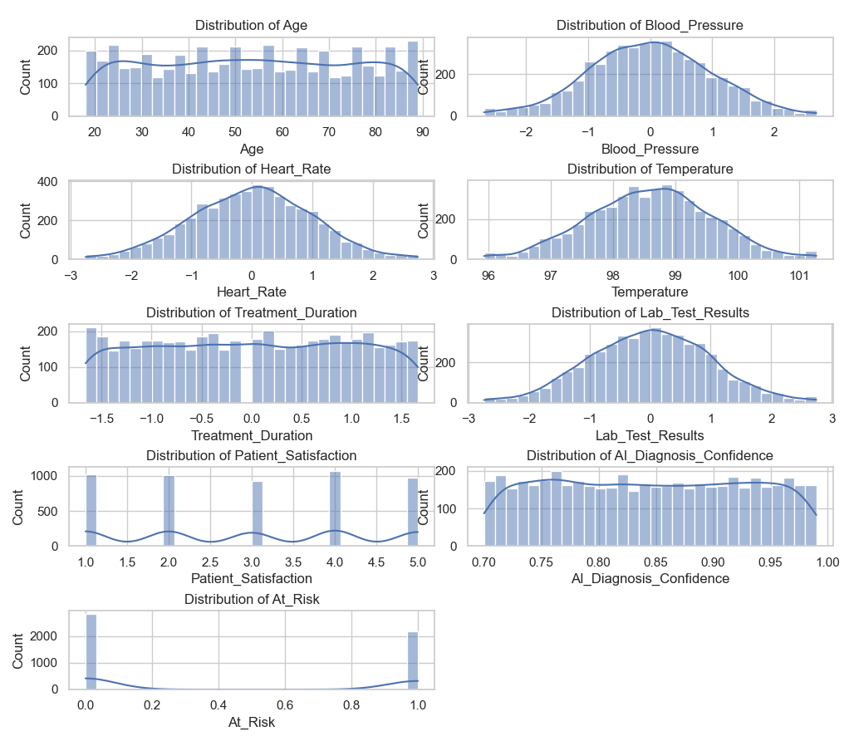
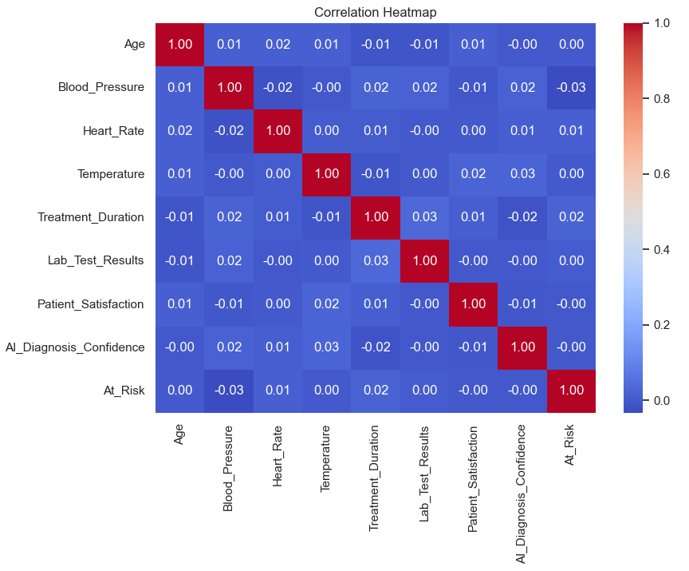
visuals

Slide 7
implementation
Data Source: Synthetic healthcare dataset from Kaggle
Target: Predict patients at risk of clinical deterioration
Data splitting: 80/20 train test split on features and target (At_Risk)
Baseline models: Random Forest, Logistic Regression
Cross-validation: 5-fold cross validation to check model stability
Hyperparameter Tuning:
RF: n_estimators=200, max_depth=10
LR: C=0.5
Imbalance handling: applied SMOTE to improve prediction of minority class (At_Risk=1)
Evaluation metrics:
Accuracy
Precision, Recall, F1-score

Slide 8
Evaluation & results
Both Random Forest and Logistic Regression were evaluated using accuracy, precision, recall, and F1-score. Baseline models achieved moderate accuracy (~54%) but struggled to identify at-risk patients, showing very low recall.
Hyperparameter tuning had minimal effect. However, after removing outliers and applying SMOTE, recall for the at-risk class significantly improved. Logistic Regression rose from 4% to 39%, and Random Forest from 16% to 28%.
This emphasizes the importance of addressing class imbalance and data quality in healthcare AI, where correctly identifying high-risk patients is far more critical than overall accuracy.
Model | Accuracy | Recall (At_Risk = 1)
Random Forest (Baseline) | 52.9% | 16%
Logistic Regression | 54.3% | 4%
RF (Tuned) | 53.6% | 3%
LR (Tuned) | 54.3% | 4%
RF (SMOTE) | 51.2% | 28%
LR (SMOTE) | 48.7% | 39%

Slide 9
Limitations & future improvements
Limitations:
Synthetic dataset – the dataset doesn’t reflect real-world patient complexity or noise.
Class imbalance – even with SMOTE, the models struggled with recall on small test sets.
Limited features – the dataset lacked real time or longitudinal patient data (data over time).
Model performance – accuracy stayed low despite tuning, especially with the minority classes.
Future Improvements:
Source a more realistic, representative dataset to improve model generalisability.
Exploring more advanced models to handle class imbalance more effectively and perhaps achieve a better performance on the dataset.
Adding ROC-AUC analysis for a deeper evaluation into the classification thresholds.
Implement feature importance and/or an explainability framework to better understand model predictions and support clinical trust.

Slide 10
conclusion
This project demonstrates how machine learning models and AI can be applied to healthcare data to predict patterns and identify patients at risk of clinical deterioration.
While baseline models struggled with class imbalance, applying SMOTE improved recall for the at risk-group, highlighting the importance of prioritising patient safety over overall accuracy.
Through model tuning, evaluation and critical reflection, this work provides the foundation for more effective, personalised and preventative AI-driven healthcare solutions.

